Slide 1
Securing your DevOps Toolchain in the Cloud
Tony Rice
Cisco Security & Trust Organization

Slide 2
Prerequisites
If you don’t already have these established, please take care of this now
Amazon AWS account (free tier is fine)
aws.amazon.com/free‎
Github.com account

Slide 3
Python Prep (for local testing)
Install Python https://www.python.org/downloads/
Install PIP https://pip.pypa.io
pip install <module>
virtualenv
pip install flask==0.10.1

Slide 4
About Me
Senior Information Security Engineer
Cisco Security & Trust Organization
Research Triangle Park, North Carolina

Slide 5
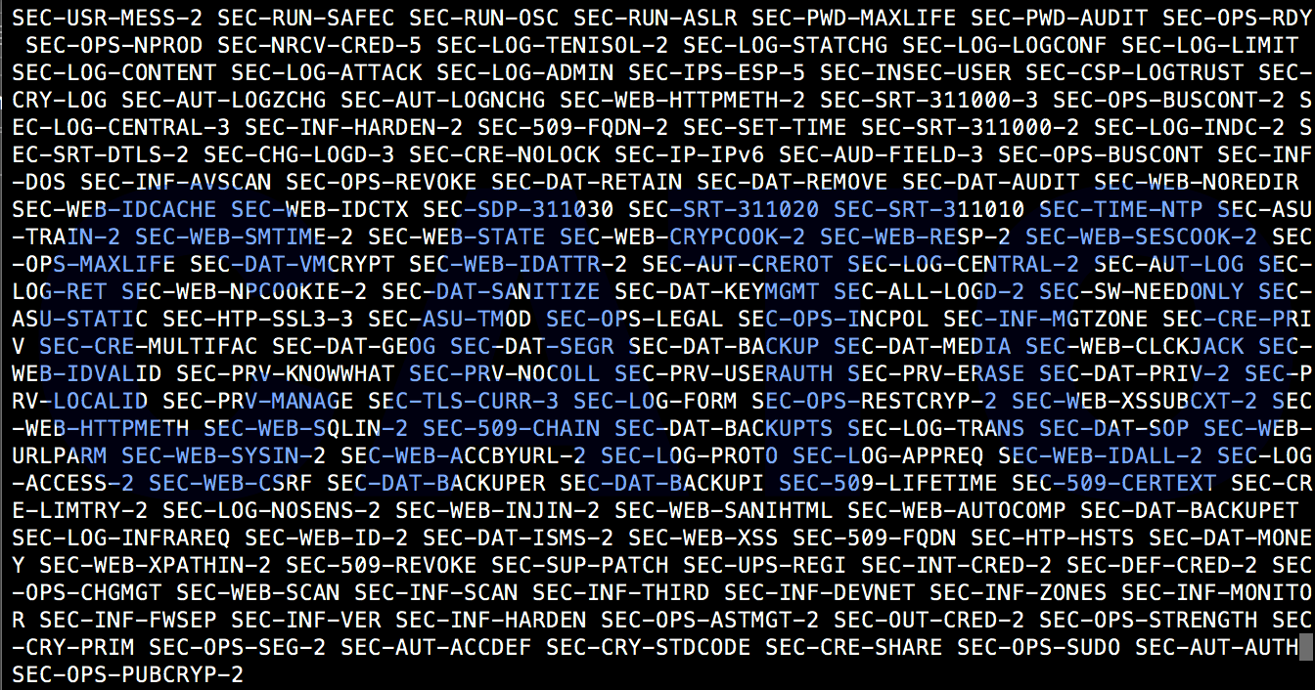

Slide 6


Slide 7
triangleinfosecon.com
Friday October 27, 2017
Raleigh Convention Center, Raleigh, NC
Notes:
Alan Pearce, a journalist who has written for Time magazine, Sky News, the BBC, and The Sunday Times covering conflicts from the Khmer Rouge to the Taliban. Today he trains other media professionals in cyber-security and digital counter-surveillance.
Pearce will speak about the dangers of the surface web, the one we all use every day, insisting it is just as dangerous as the deep web.
Nichole Eagan, CEO of Darktrace a global machine learning company for cyber defense, will provide the afternoon keynote. Nicole was named ‘Woman of the Year’ at the 2016 Cyber Security Awards for successfully introducing disruptive machine learning technology to the global market.
Eagan will speak about the cyber security arms race and how artificial intelligence-based systems to continually measure the security of business environments.

Slide 8
In this workshop we will setup
A source code repository
A centralized build server
Deploy a simple micro service into the cloud
Along the way, we’ll form them into a continuous integration toolchain … securely

Slide 9

Code pipeline
SOURCE
BUILD
STAGING
PRODUCTION
Developers
commit code & test changes
Changes are built ..
… and tested
Deployed to
public servers

Slide 10







Our Continuous Delivery Pipeline
Source Code
Management
Build
Identity
Deployment
Deploy
Trigger build
Trigger deployment
GitHub
EC2
IAM
Elastic
Beanstalk

Slide 11
Agenda
1-1:30 overview / AWS and Git prerequisites
1:30-1:45 Fork the GitHub Hello Word Repo
1:45-2:30 Provision EC2, Elastic Beanstalk and security groups
2:30-3:00 install Jenkins with Git and EB plugins
break
3:30-4:30
trigger Jenkins builds from GitHub updates via keys,
trigger deployment from Jenkins to Elastic Beanstalk via keys
4:30-5:00 CI/CD best practices
Cisco Public 2017 All Rights Reserved

Slide 12
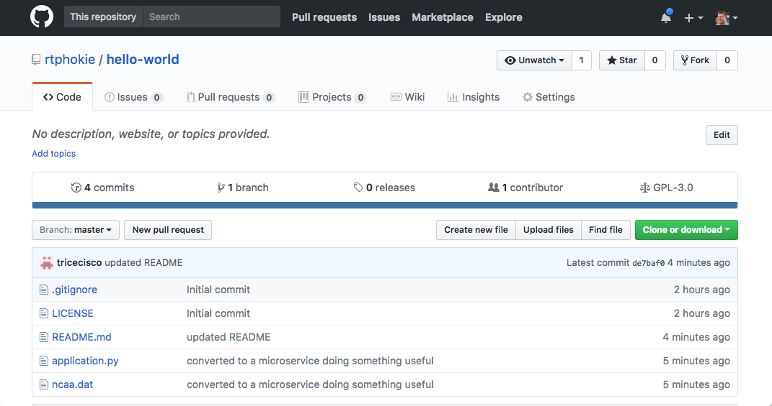
Get the app source code from GitHub
Visit https://github.com/rtphokie/hello-world
Pull … then clone
Clone

Slide 13
Get the app running locally
virtualenv ~/eb-virt
source ~/eb-virt/bin/activate
git https://github.com/rtphokie/hello-world.git or download from Box (http://bit.ly/isaca-hello-world)
cd hello-world
pip install –r requirements

Slide 14
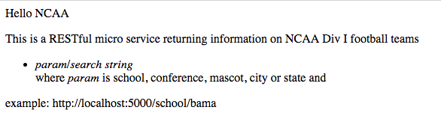
Test application locally
python application.py
Visit http://localhost:5000

Slide 15
Our Continuous Delivery Pipeline
Source Code
Management
GitHub

Slide 16
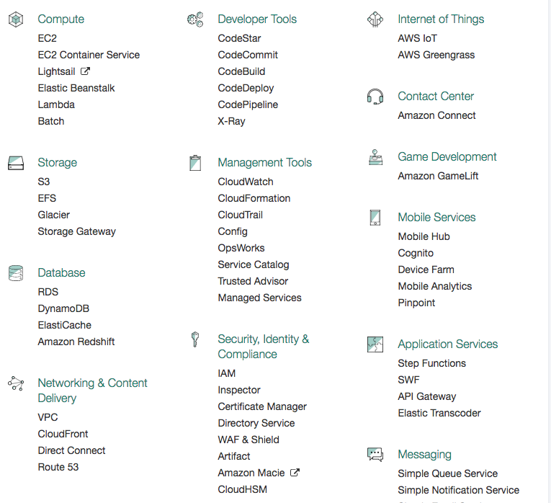
AWS console
We will be using
EC2
Security Groups
Instances
IAM
Elastic Beanstalk

Slide 17
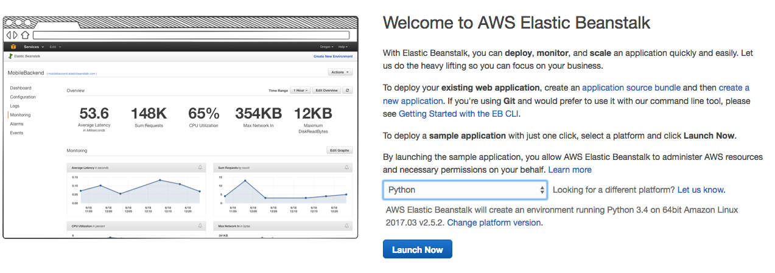
Elastic Beanstalk: Provision
2.7 on 64 Bit Linux

Slide 18
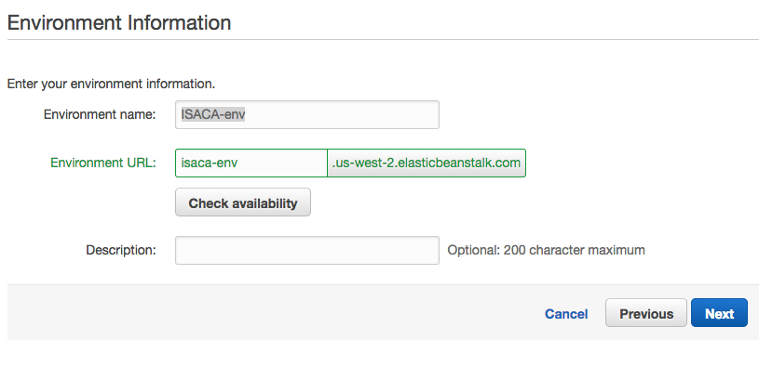
Elastic Beanstalk provision
Create Environment
Create Webserver (Python, change to 2.7; single instance)
Use sample application
Launch

Slide 19
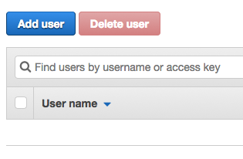
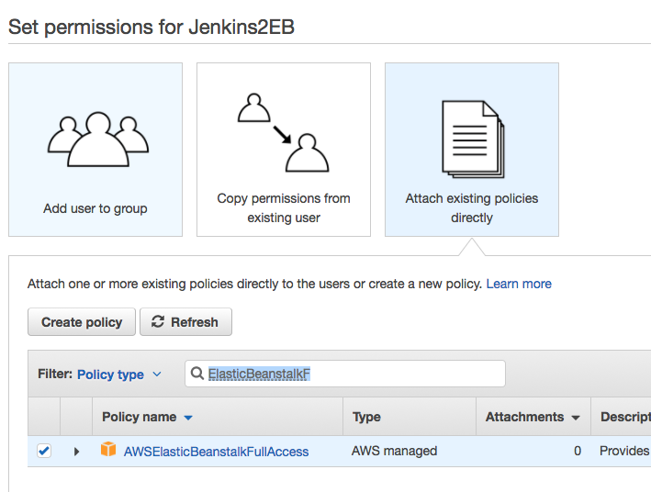
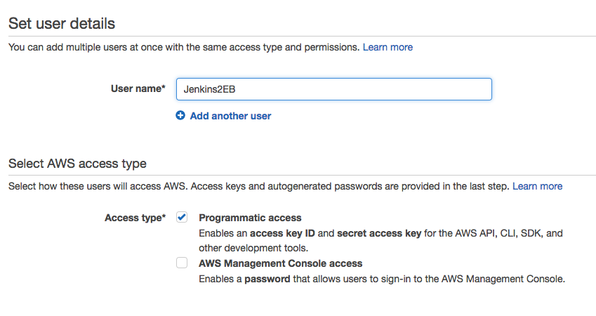

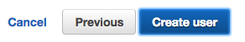
IAM: Provision EB User
AWSElasticBeanstalkFullAccess

Slide 20
Our Continuous Delivery Pipeline
Source Code
Management
Build
Identity
Deployment
GitHub
EC2
IAM
Elastic
Beanstalk

Slide 21
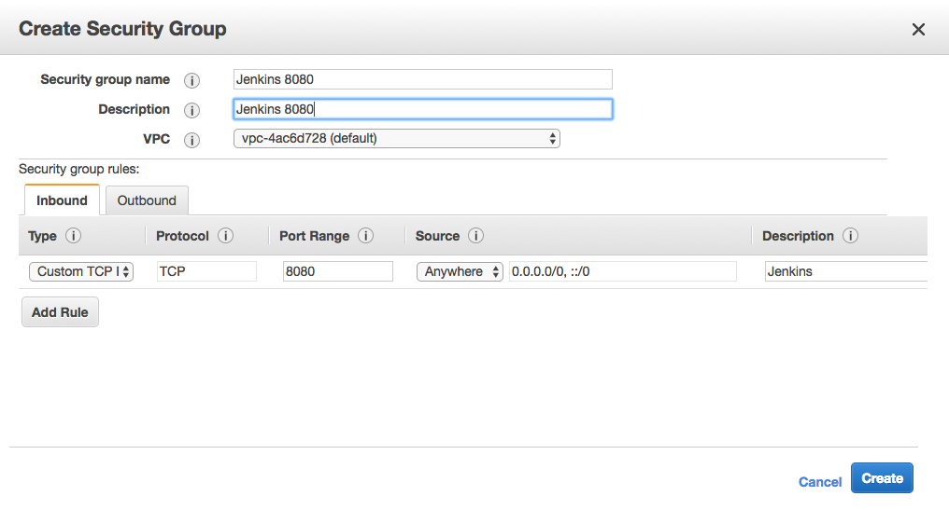
EC2: security group
Add access to port 22
While you are creating this

Slide 22
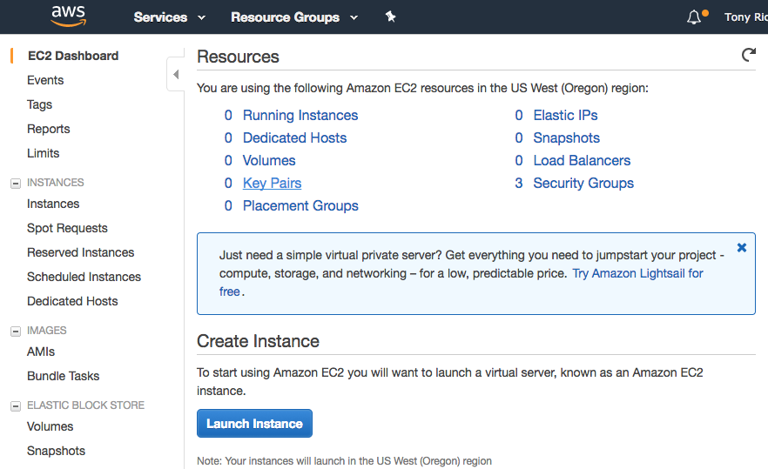
EC2: launch EC2 instance

Slide 23
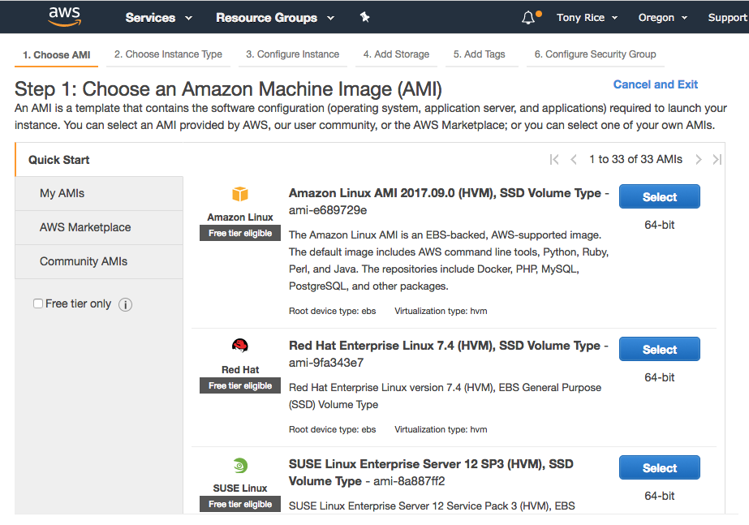
AWS: launch EC2 instance

Slide 24
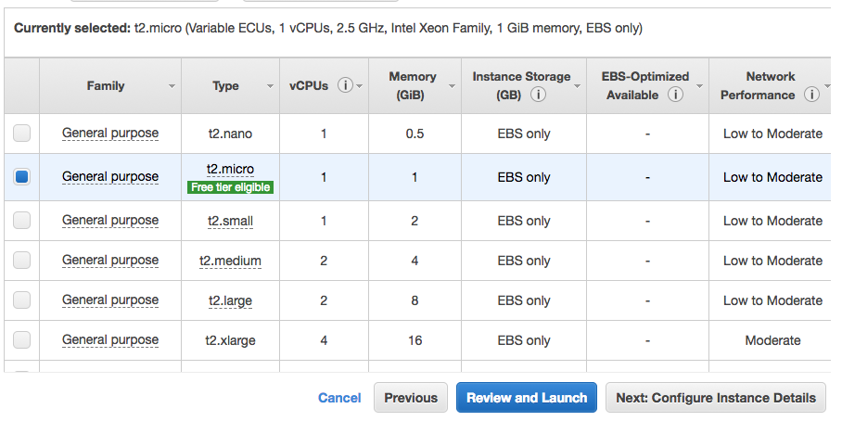
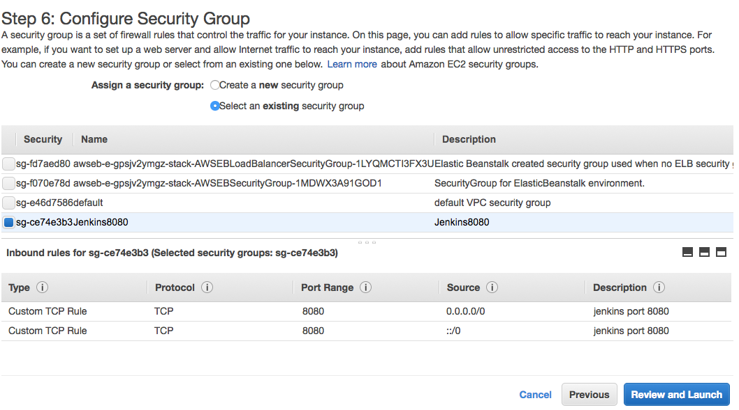
Select a free tier eligible instance type, launch

Slide 25
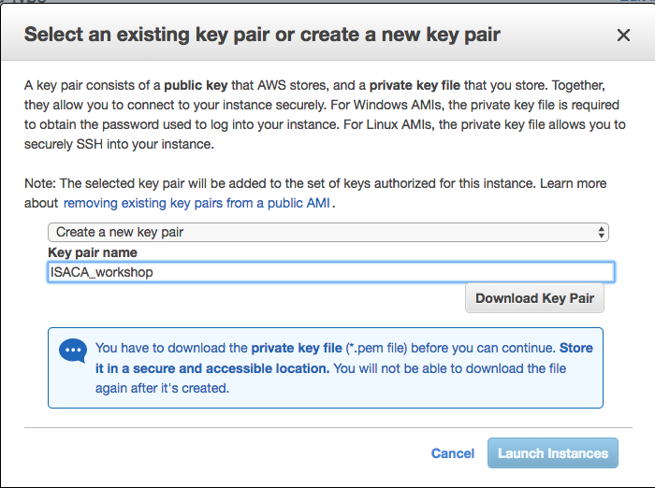
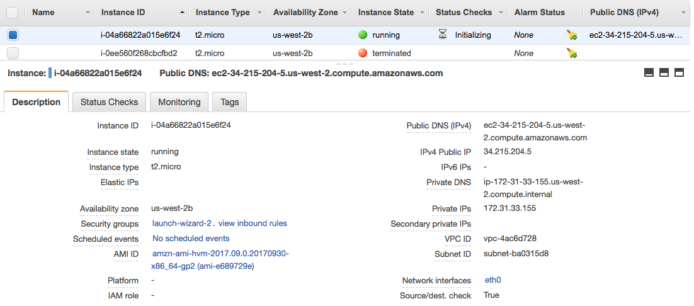
Create key pair & launch

Slide 26
~/.ssh/config shortcut
host isaca
User ec2-user
Hostname 34.215.204.5
IdentityFile /Users/trice/Downloads/ISACA_workshop.pem
$ sudo yum –y update Loaded plugins: priorities, update-motd, upgrade-helper
amzn-main | 2.1 kB 00:00:00
amzn-updates | 2.5 kB 00:00:00
Resolving Dependencies
--> Running transaction check
---> Package amazon-ssm-agent.x86_64 0:2.1.4.0-1.amzn1 will be updated

Slide 27
Login!
$ chmod 600 ~/Downloads/ISACA_workshop.pem
$ ssh -i ~/Downloads/ISACA_workshop.pem ec2-user@34.215.204.5
Warning: No xauth data; using fake authentication data for X11 forwarding.
X11 forwarding request failed on channel 0
__| __|_ )
_| ( / Amazon Linux AMI
___|\___|___|
https://aws.amazon.com/amazon-linux-ami/2017.09-release-notes/
No packages needed for security; 5 packages available
Run "sudo yum update" to apply all updates.

Slide 28
Jenkins

Slide 29
Jenkins: installation
$ sudo yum update –y $ sudo yum install -y git
$ sudo wget -O /etc/yum.repos.d/jenkins.repo \ http://pkg.jenkins-ci.org/redhat/jenkins.repo $ sudo rpm --import https://pkg.jenkins.io/redhat/jenkins.io.key
$ sudo yum install –y jenkins
$ sudo service jenkins start
Starting Jenkins [ OK ]
https://d0.awsstatic.com/Projects/P5505030/aws-project_Jenkins-build-server.pdf

Slide 30
If you get Java8 errors
$ sudo service jenkins start
Starting Jenkins Jenkins requires Java8 or later, but you are running 1.7.0_151-mockbuild_2017_08_09_21_42-b00 from /usr/lib/jvm/java-1.7.0-openjdk-1.7.0.151.x86_64/jre
java.lang.UnsupportedClassVersionError: 51.0
at Main.main(Main.java:124) $ sudo yum –y install java-1.8.0
$ sudo yum –y remove java-1.7.0-openjdk
$ sudo service jenkins start
Starting Jenkins [ OK ]
$

Slide 31
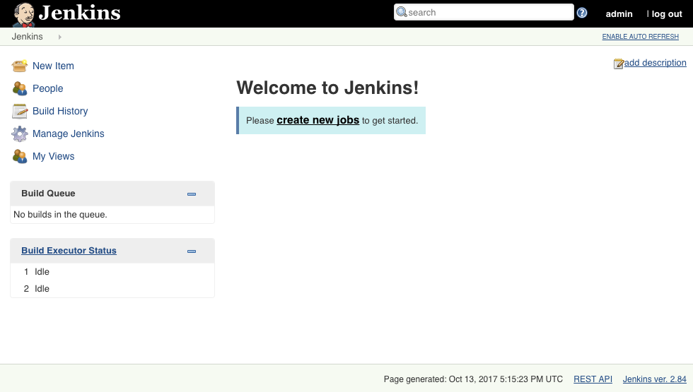
Jenkins: Login
From EC2 Linux prompt
$ sudo cat /var/lib/jenkins/secrets/initialAdminPassword
somestring
http://publicip:8080

Slide 32
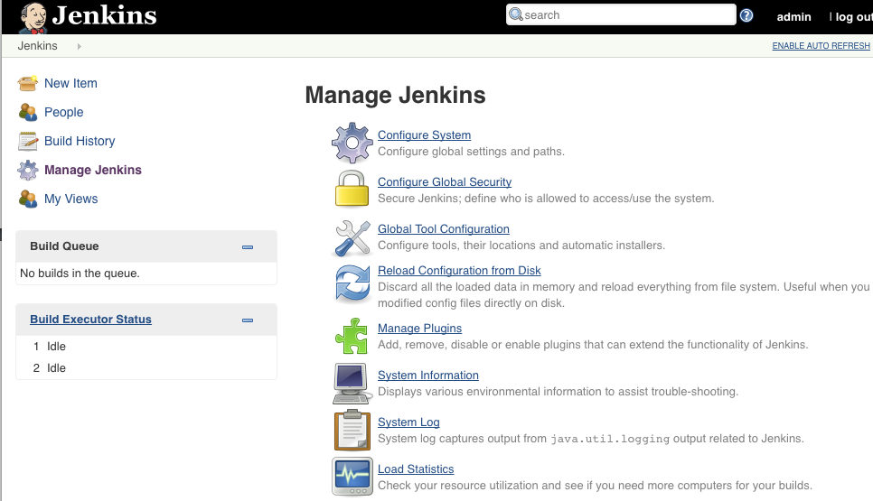
Jenkins: Plugins
Install these plugins
AWS Elastic Beanstalk Deployment Plugin (not Publisher)
GitHub Authentication

Slide 33
Our Continuous Delivery Pipeline
Source Code
Management
Build
Identity
Deployment
GitHub
EC2
Elastic
Beanstalk

Slide 34
Create a key pair
Login to EC2 instance
sudo su – jenkins
ssh-keygen -t rsa
Public and private is_rsa files are in ~jenkins/.ssh

Slide 35
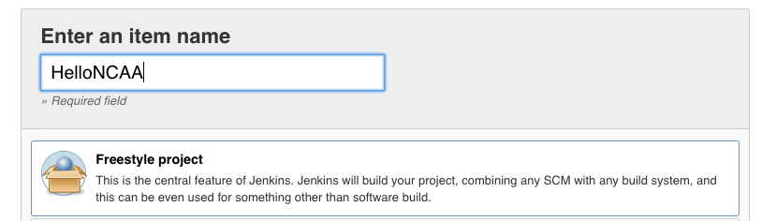
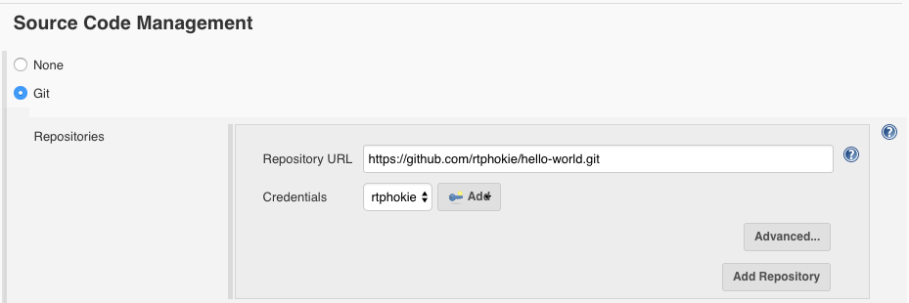
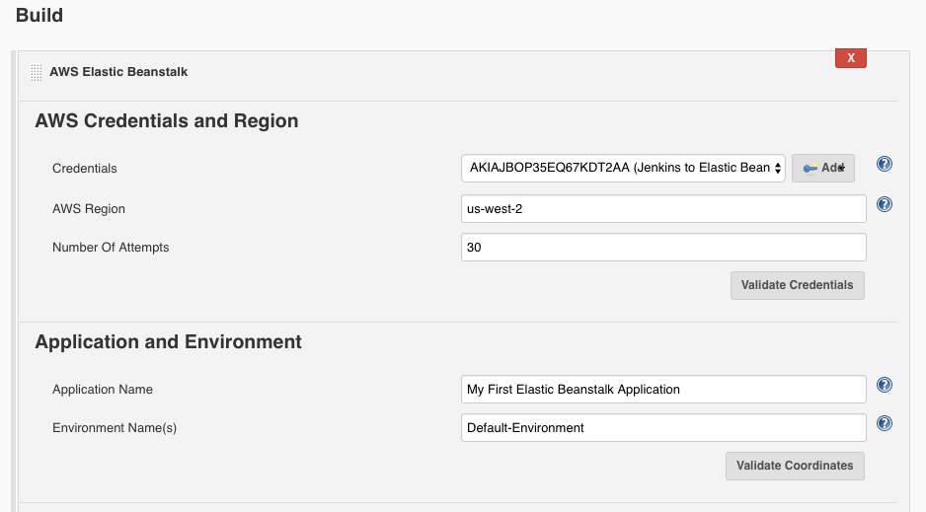
Create a build job
Click New Item, select Freestyle project

Slide 36
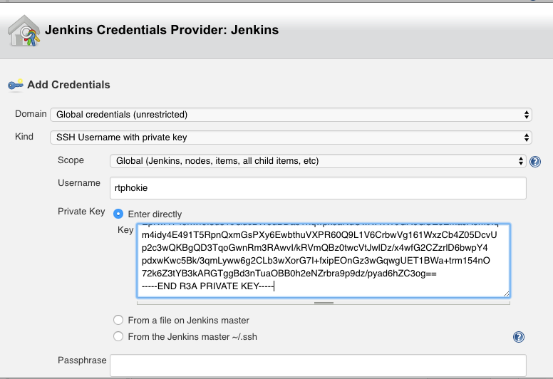
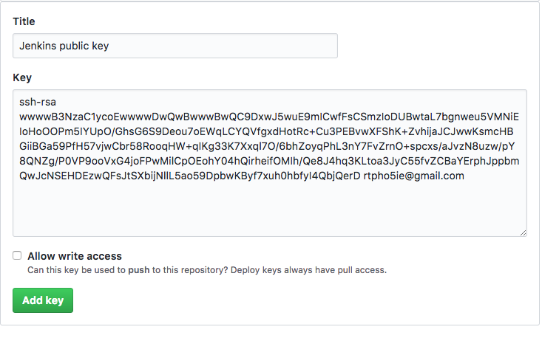
Github: Deploy key
`
$ ssh-keygen -t rsa -C ‘trice@cisco.com’
Github
Public key
Jenkins
Private Key

Slide 37
Apply Public Key to Github
Settings >> Deploy keys
Click Add Deploy Key enter public key enter a title

Slide 38
Apply Private Key to Jenkins Job
New Freestyle Job
Source Code Mgmt->Git url: https://github.com/rtphokie/hello-world.git
Click add key SSH with key enter userid enter Private key click add

Slide 39
Our Continuous Delivery Pipeline
Source Code
Management
Build
Identity
Deployment
Trigger build
GitHub
EC2
IAM
Elastic
Beanstalk

Slide 40
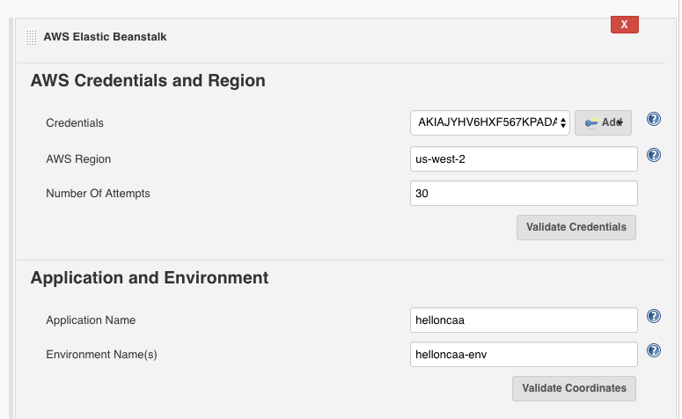
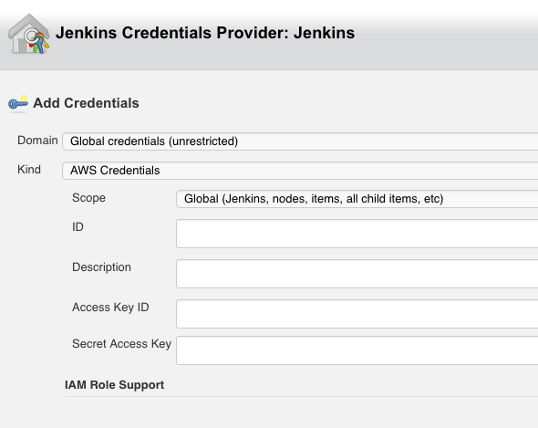
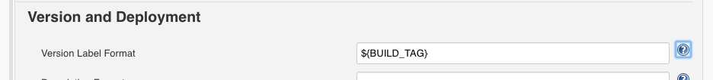
Jenkins: deploy to EB post build
Select AWS Credentials

Slide 41
Artifact Management
Production
Deployment
Source Code
Management
Build
Artifacts
Identity
Deploy
Trigger build
GitHub
IAM
Elastic
Beanstalk
EC2

Slide 42
Before you go
AWS bills based on running and stopped instances. To avoid unexpected bills:
Shutdown your EC2 instances and Elastic Beanstalk apps.
Terminate them ASAP

Slide 43
Thank you.
trice@cisco.com
@rtphokie
Cisco Public 2017 All Rights Reserved

